Slide 1

Patients Attending Medical Appointments
Exploratory Data Analysis (EDA)
Abdulelah Ibrahim Aldossari

Slide 2


Objects
1. Introduction
2. Data Cleaning and Preparation
3. Data Visualization
4. Conclusion

Slide 3
Introduction
When a patient makes a medical appointment, receives all the instructions, and does not attend the appointment, Should we blame the patient? Or the hospital?
In this project, we will talk about the problem of patients not attending their appointments, knowing the reasons of this problem, and proposing solutions to it.

Slide 4
Data Used
The dataset called "Medical Appointment No Shows", which contains 110,527 medical appointments and 14 features. The most important one is "no-show", which will tell us if the patient attends the appointment or not.
The timeline of the dataset starts from November 10, 2015, to June 23, 2016.
I got rid of some invalid values in the data set by resetting them to zeros, such as negative values in the "age" and "days left" columns.

Slide 5

Questions should be answered
What are the top three features affecting patients' attendance for their appointments?
Is there a correlation between one feature and another?
What do you suggest to solve this problem?

Slide 6
What are the Data Features?
Appointment ID | Patient ID
Scheduled Day | Gender
Age | Appointment Day
Scholarship | Neighborhood
Diabetes | Hypertension
Handicap | Alcoholism
No-show | SMS_received

Slide 7
Libraries Used
Numpy
Pandas
Matplotlib.pyplot
Seaborn
Datetime

Slide 8
Libraries Used
Numpy
Pandas
Matplotlib.pyplot
Seaborn
Datetime

Slide 9
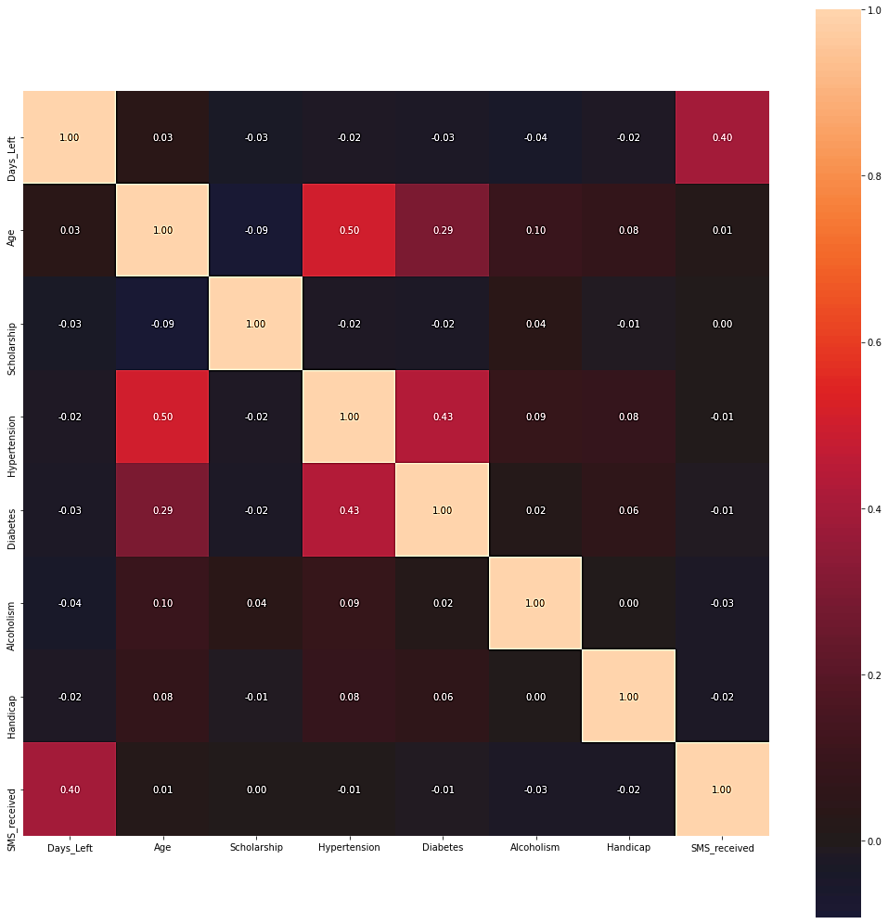
Correlation between features
The values in each cell represent a meaning, for example:
1 : This value means that the correlation between the two features is a positive correlation.
-1 : This value means that the correlation between the two features is negative correlation.
0 : This value means that there is no correlation between the two features.
So, we can say the more the value in the cell is to 1 or -1, the more there is a correlation between the two features.

Slide 10
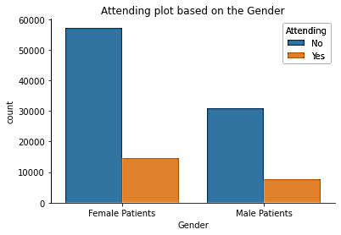
Number of male patients comparing with female patients
the percentage of patients who did not attend their appointments is 80%, and this indicates that there is a problem that must be considered and resolved.

Slide 11
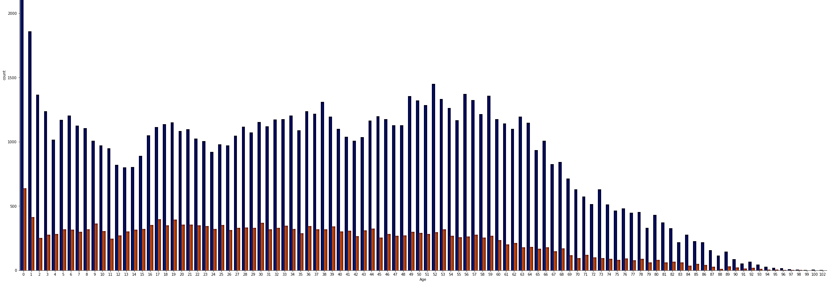
Comparing Age with number of patients
the number of patients who attend appointments goes through an increase and decrease with increasing age, but the number of patients continues to decrease after age 53.

Slide 12
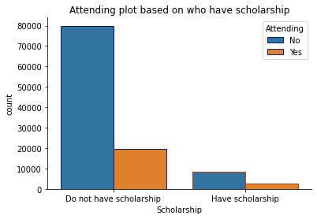
Comparing having Scholarship with number of patients
the number of patients who attended the appointments and have scholarship is much higher than the number of patients who attended the appointments and do not have scholarship.

Slide 13
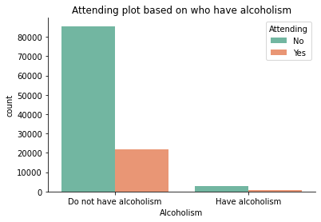
Comparing having Alcoholism with number of patients
the number of patients who attended appointments and have alcoholism is very small compared to the number of patients who attended appointments and do not have alcoholism.

Slide 14
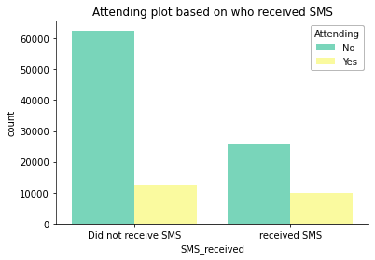
Comparing Receiving SMS with number of patients
the number of patients who attended the appointments and received SMS is more than those who did not receive SMS.

Slide 15
Answers to the questions
What are the top three features affecting patients' attendance for their appointments?
There are many features that affect patients' attendance to their appointments, but the three most prominent features are:
1. Alcoholism
2. Scholarship
3. Gender

Slide 16
Answers to the questions
Is there a correlation between one feature and another?
Based on the heatmap, there are some features that have a correlation with other features, for example:
Age and Hypertension
Diabetes and Hypertension
Days_Left and SMS_received

Slide 17
Answers to the questions
What do you suggest to solve this problem?
We must look for the reasons and try to reduce them as much as possible, for example:
Age: Patients over the age of fifty, we ask them to choose a family member as responsible for him, and we remind them of the appointment every two or three days.
Scholarship: Trying to increase the number of patients who have a scholarship, by asking the competent authorities and convincing them.
Alcoholism: Spreading awareness about the dangers of alcohol addiction, persuading the alcohol addicted patient to join clinics to quit drinking alcohol.
SMS_received: Sending an appointment reminder message to the patient’s phone on the scheduled day, and another message 24 hours before the appointment day.

